Slide 1
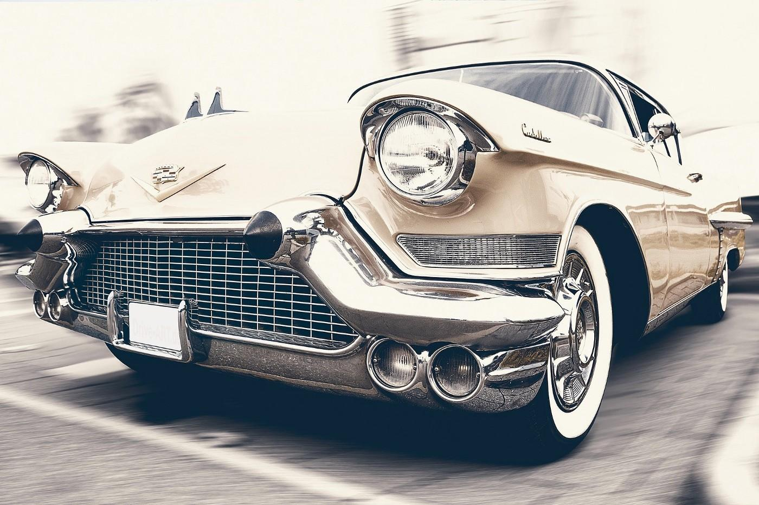
PREDICTING CAR PRICE
Abdullah DOĞAN

Slide 2
Table of Contents
01
02
03
04
Scraping the web with beautifulsoup and selenium
Basic feature engineering and visualizing with seaborn and plotly
Build linear regression models with sklearn and stats model
Choosing the best model of prediction

Slide 3
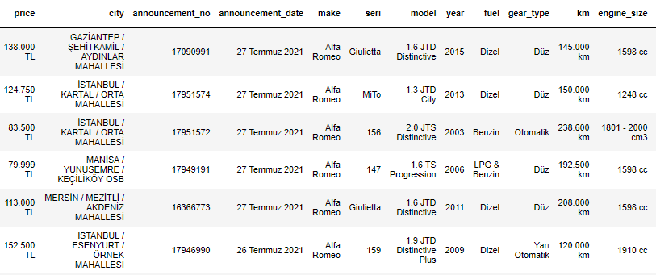
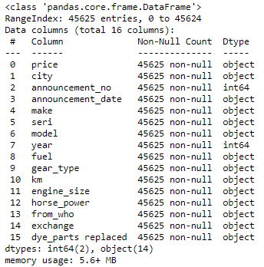

Slide 4
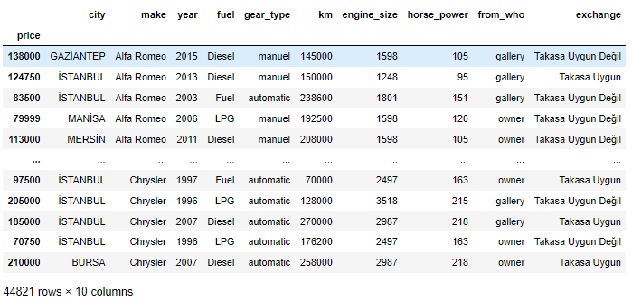
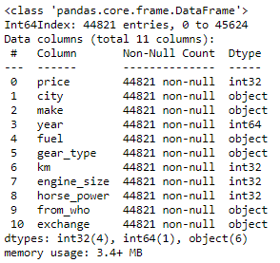

Slide 5
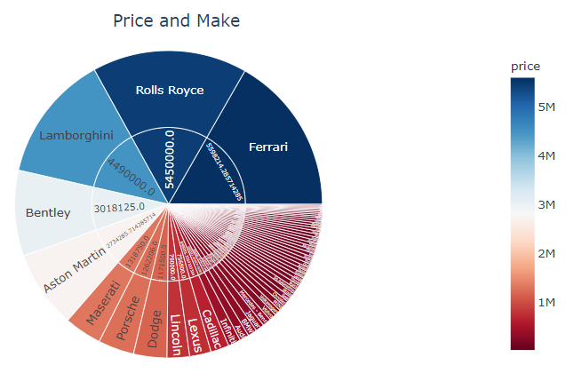
The most costly car is a Ferrari.
A Lada is the cheapest car.

Slide 6
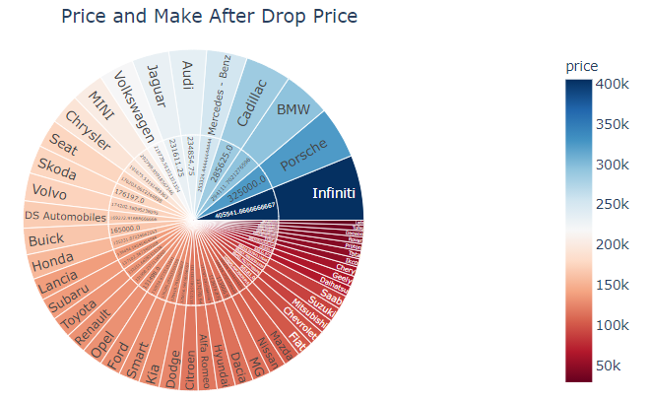
The most costly car is an Infiniti.
A Lada is the cheapest car.

Slide 7
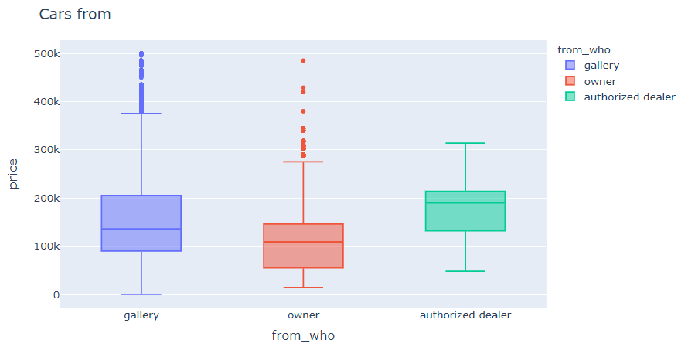
Car owners sell the cheapest vehicles.

Slide 8
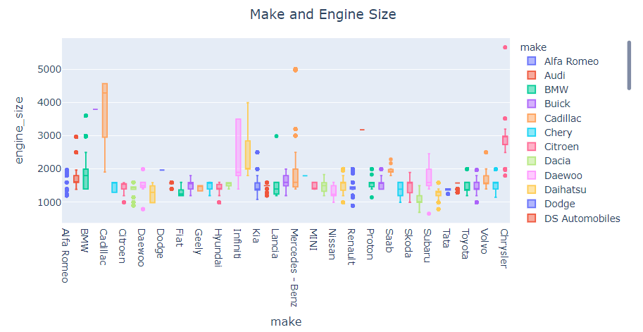

Slide 9
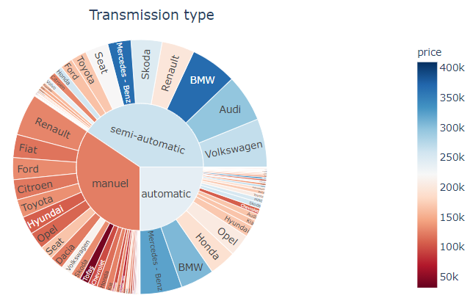
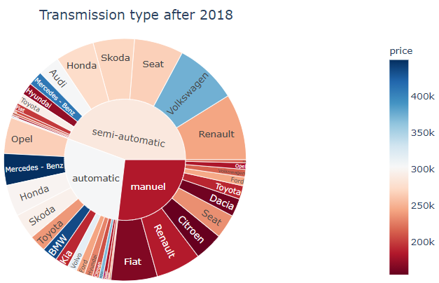

Slide 10
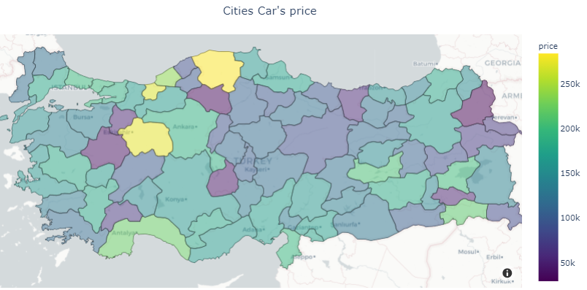

Slide 11
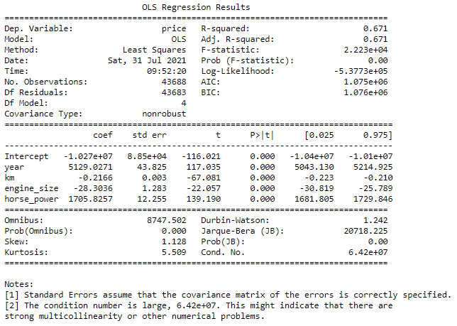

Slide 12
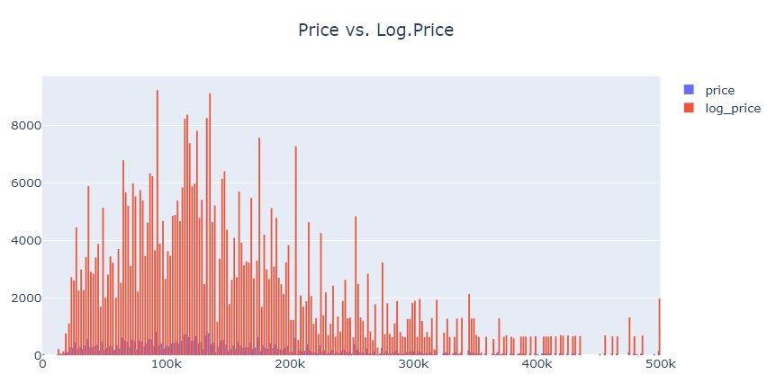

Slide 13
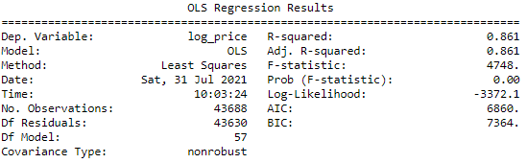
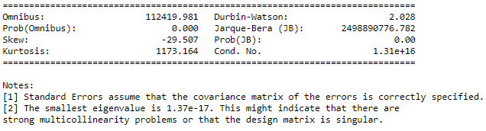
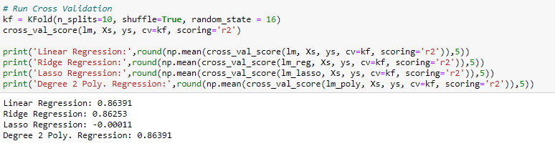

Slide 14
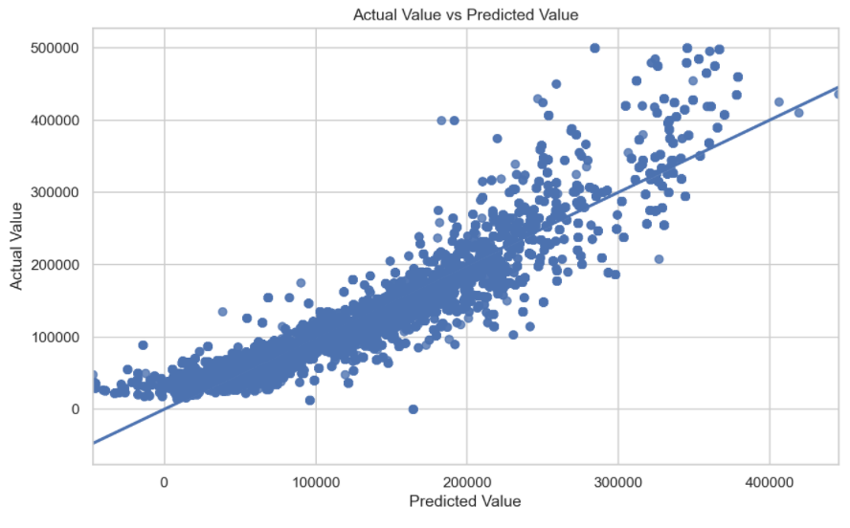

Slide 15
FUTURE WORK
More automobiles will be added.
More car’ features will be added (like cylinder, door)
Applying more future engineering (like grouping by kilometer)
Adding vehicle models

